Slide 1
OBJECT DETECTION BY USING OPENCV
RUSHABH PAWAR – B 24
V.Nithin-B64

Slide 2
INTRODUCTION :
Object detection is scanning and searching for an object in an image or a video.
Object detection is a common term for computer vision techniques classifying and locating objects in an image or a video
Computer vision has been around for decades and has lots of different uses in the real world
Some examples are facial recognition and Self driving cars etc.
The entire concept of computer vision relies heavily upon machine learning, especially in this day

Slide 3
Motivation And Purpose :
The basic motivation behind this topics is that it is something that will overdo all the physical tasks.
Robotics and smart systems are buzzing around all over the world
Object recognition and tracking reduce human efforts and provides efficiency.
Automatics recognition and extraction adds to the smart systems used today.

Slide 4
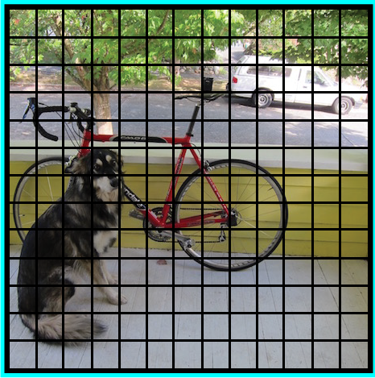
A GENERAL FRAMEWORK FOR OBJECT DETECTION :
we follow three steps when building an object detection framework:
First, a deep learning model or algorithm is used to generate a large set of bounding boxes spanning the full image (that is, an object localization component)

Slide 5
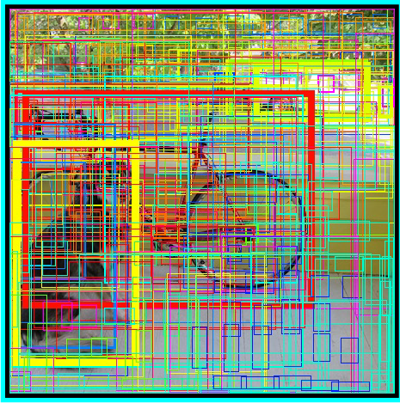
2) Next, visual features are extracted for each of the bounding boxes.
They are evaluated and it is determined whether and which objects are present in the boxes based on visual features
(i.e. an object classification component)

Slide 6
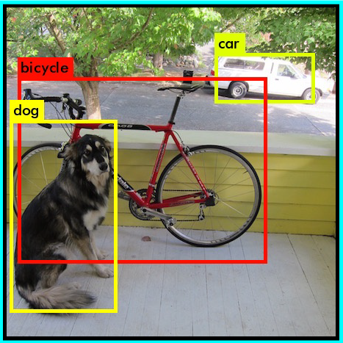
3) In the final post-processing step, overlapping boxes are combined into a single bounding box (that is, non-maximum suppression)

Slide 7
DATASET AND PROCESSING:
. COCO stands for Common Objects in Context, this dataset contains around 330K labelled images.
COCO is a large-scale object detection, segmentation, and captioning dataset

Slide 8
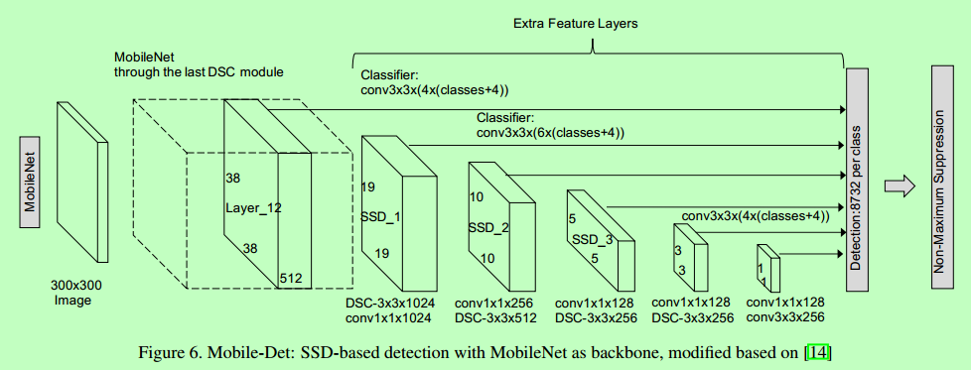
MobileNet V3- SSD:-
The SSD architecture is a single convolution network that learns to predict bounding box locations and classify these locations in one pass . thus SSD much faster than RPN-based approach.
This Single Shot Detector (SSD) object detection model uses Mobilenet as backbone and can achieve fast object detection

Slide 9
ADVANTAGES OF MOBILENET V3 ARCHITECTURE:
● The main advantages is their accuracy in image.
● It takes less time.
● Improve the quality of candidate bounding boxes.

Slide 10
REFERENCES:
1https://www.diva-portal.org/smash/get/diva2:1242627/FULLTEXT01.p
2. https://www.xcaliberinfotech.com/used-lance/ssd-vs-yolo.html
3..https://www.diva-portal.org/smash/get/diva2:1242627/FULLTEXT01.p
4https://docs.openvinotoolkit.org/latest/omz_models_public_ssd_mobilenet_v2_coco_ssd_mobilenet_v2_coco.html.

Slide 11
THANK YOU

